Slide 1
PBHS 31001: Epidemiologic Methods 2024
STATA Session 4
(Slides are adopted from previous TA’s)

Slide 2
Topics (lab session 4)
Review cs command from last session
Confounding
Interaction/effect modification
Review multiple linear regression model
Brief overview of survival analysis
Will be using the Framingham dataset (again!) as an example
Key variables:
MI_FCHD: Hospitalized Myocardial Infarction or Fatal Coronary Heart Disease
CURSMOKE: currently a cigarette smoker
TIMEMIFC: time to the first MI event during follow-up (days)
For groups with no event, this would be the time up to the end of follow-up.

Slide 3
Review – from last Stata Session
We have looked at commands to
analyze cohort study data (cs and ir, for cumulative incidence and incidence rate, respectively)
analyze case-control data (cc, for generating odds ratios)
The syntax for each command is:
cs [outcomeVar][exposureVar]
ir [outcomeVar][exposureVar][timeVar]
cc [outcomeVar][exposureVar]

Slide 4
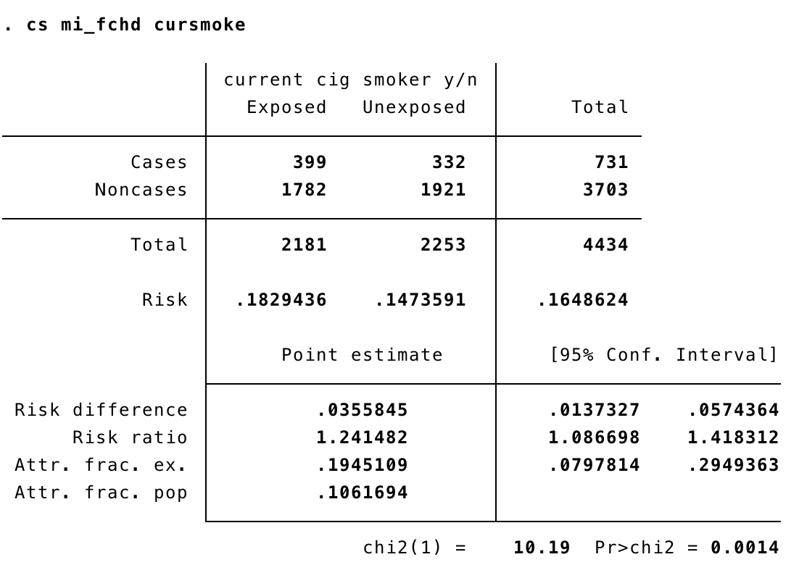
Review – from last Stata Session
Output for cs command:

Slide 5
Review – from lecture
Confounding:
Three criteria for a confounder
A confounder must be an extraneous risk factor for the disease
A cause of the disease or a surrogate of cause of the disease
A confounder must be associated with the exposure under study in the source population
It precedes and is associated with the exposure in the source population.
A confounder must not be affected by the exposure or the disease, not in an intermediate step in the causal pathway
It is important to have a conceptual model for potential confounding before starting analysis!

Slide 6
Identifying confounding in data analysis
Is the potential confounder a risk factor for the disease?
Is the potential confounder associated with the exposure?
X: Smoking
Sex(Female)
Y: CVD

Slide 7
Ways to adjust for confounders (from lecture)
At the design phase
Matching
Randomization
At analysis phase
Stratification
Adjustment through regression

Slide 8
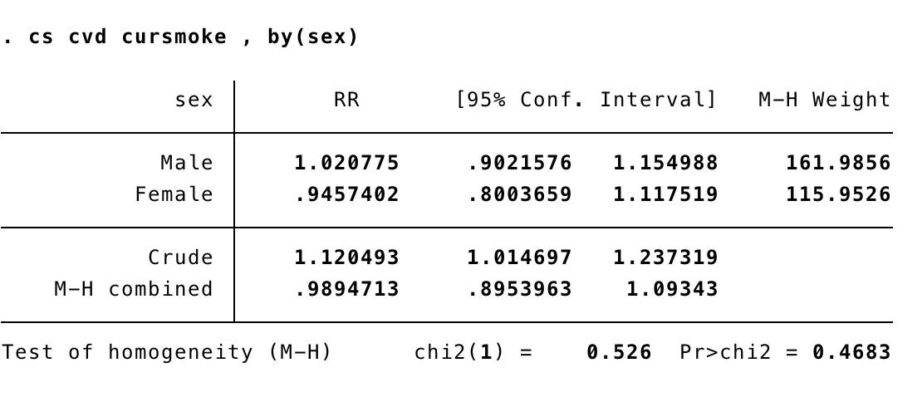
Stratified analysis (MH Combined RR), using cs
To evaluate confounding, we can compare a crude measure of association to an adjusted measure of association – one such adjusted measure is a Mantel-Haenszel adjusted RR
cs [outcomeVar][exposureVar], by [confoundVar]
Is there evidence of confounding?

Slide 9
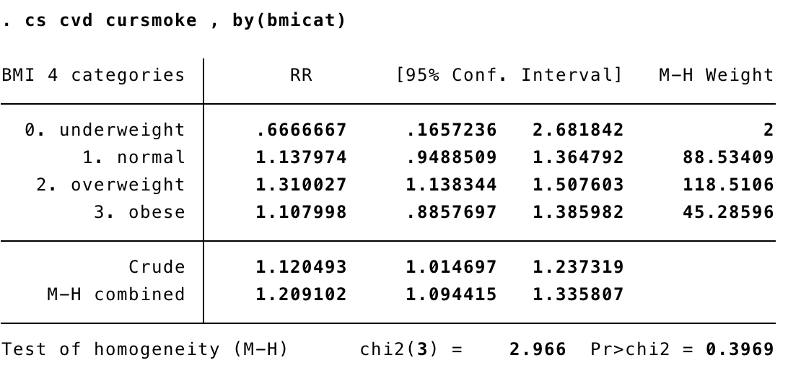
Is BMI a confounder?
Is there evidence of confounding?
Should we include it in the model anyway?

Slide 10
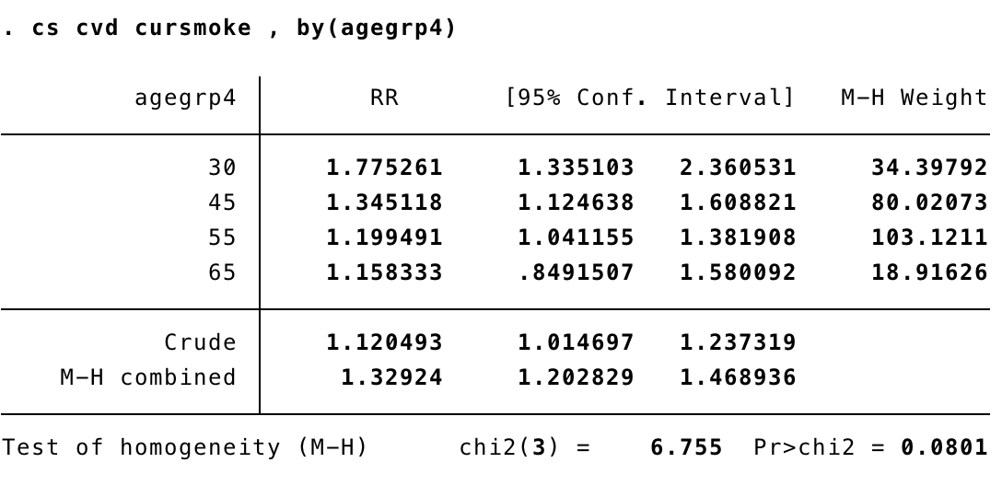
What about age?

Slide 11
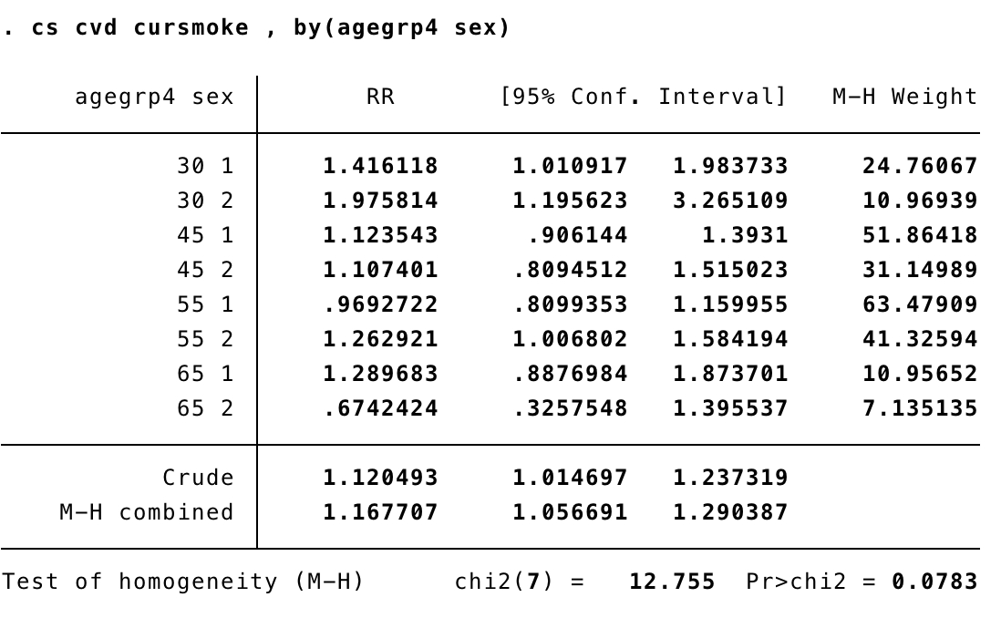
You can combine many variables
But be careful, if you add too many you will increase the chances of finding a cell where no combinations occur

Slide 12
Testing for trend – categorical variables
“Is increasing exposure associated with increasing probability of the outcome?”
Versus “Is exposure associated with outcome?”
This is called “testing for trend”
For use with ordered categorical variables (e.g. BMI is ordered. Race is not)
tabodds [outcomeIndicator] [exposureVar]

Slide 13
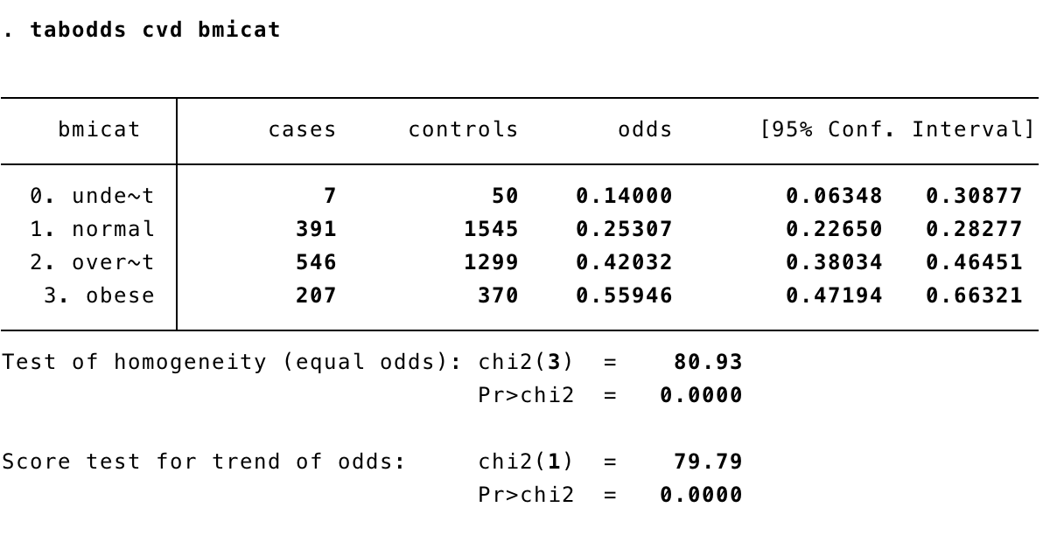
Testing for trend – categorical variables
Score test for trend of odds
If p is less than 0.05, then you reject the hypothesis that there is no linear trend relationship
Interpretation: if p < 0.05, you think that as your categories increase, the probability of your outcome also increases

Slide 14
Testing for trend – categorical variables
tabodds [outcomeIndicator] [exposureVar], or
Gives odds ratios, using the first category as a reference
tabodds [outcomeIndicator] [exposureVar], or base([n])
Gives odds ratios, using the nth category as a reference
tabodds [outcomeIndicator] [exposureVar], ciplot
Gives visualization of the trend
Worth noting: the order of your exposure variable matters, but not its absolute magnitude

Slide 15
mhodds Command
Similar to tabodds, but
Will calculate test for trend based on one-unit increase in your exposure
ie: both magnitude AND order matter
Allows you to stratify based on possible confounders
tabodds answers two questions:
Are the odds same for all exposure levels?
If they are not the same, do they follow a linear trend?
mhodds answers two questions
Is there a linear trend?
What is the OR comparing exposures that have a 1-unit difference between them

Slide 16
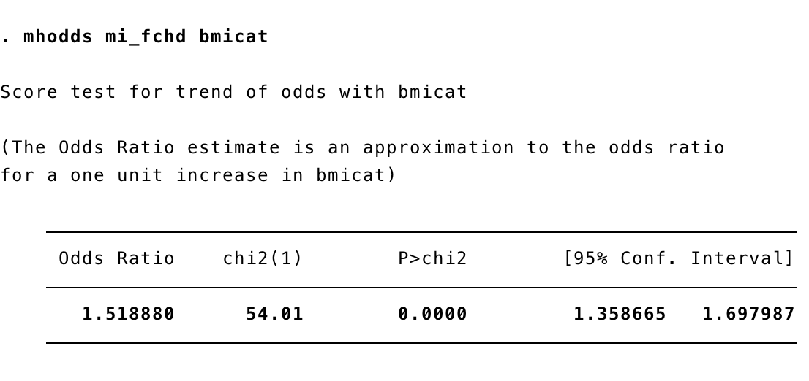
mhodds Command
mhodds [outcomeInd] [exposureCat]

Slide 17
mhodds Command - adjustment
mhodds [outcomeInd] [exposureCat], by [confoundInd]
Now answering a slightly different question
For each value of the confounding indicator, what is the OR comparing exposures that have a 1-unit difference between them?
Are these ORs the same?
When the two ORs are pooled in a statistically responsible way, what would the combined OR be?
This is your OR estimate “adjusting for” the confounding variable

Slide 18
Detecting effect modification
Interaction/effect modification: when the association estimate of an exposure differs depending on the status of a third factor (or levels of the third factor), then we say that the effect is modified by the third factor.
Detecting interaction by the homogeneity strategy: the strategy is based on stratifying your risk estimates by the suspected effect modifier and comparing risk estimates across the strata. When interaction is present, these strata-specific risk estimates will be different from each other.
We can test this using the MH statistics; the H0 is that the strength of the association is homogenous across all strata
We can use the cs command

Slide 19
Detecting effect modification: the cs command
Is there evidence of effect modification?

Slide 20
Review (Why Regression Models)
Stratified analysis using tabular and graphical method
Easy to be interpreted
Limits of # of variables
Only categorical predictors
Regression models
Simultaneously handle multiple variables
Sometime difficult to interpret

Slide 21
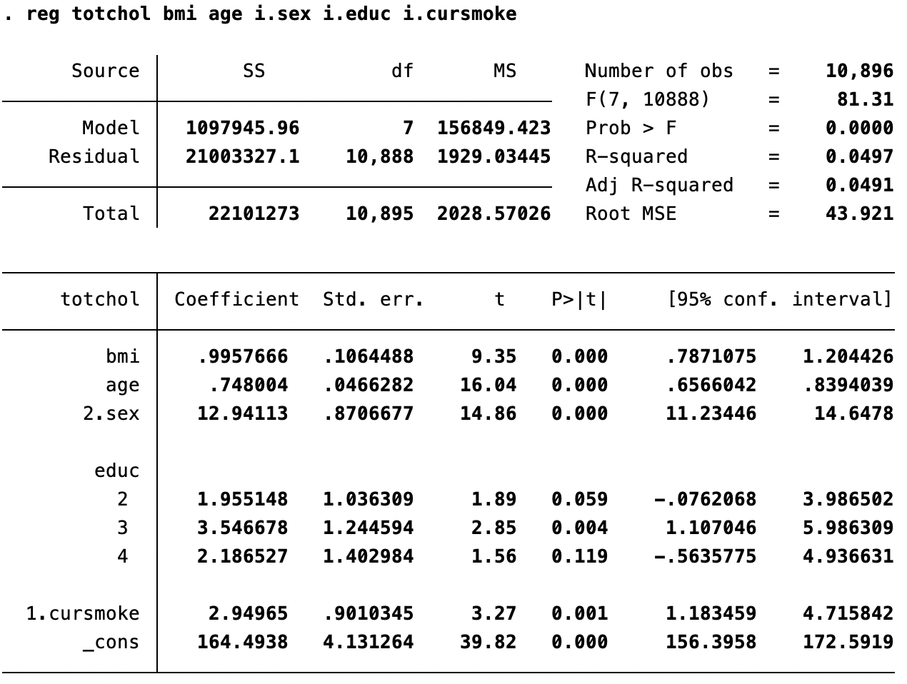
Review (Multivariable Linear Regression)

Slide 22
Overview of Survival Analysis with STATA

Slide 23
Definitions
Survival analysis
Describes the survival distribution when the risk of the outcome changes over time
Answers whether & when outcome happens)
Accounts for censoring: individuals whose outcome were not observed

Slide 24
Methods
Life table: events in intervals
used to calculate “life expectancy”
Kaplan-Meier estimator: exact event time
Log rank test
Visualization
Cox proportional hazard model: exact time
Regression approach
Notes:
Will talk about KM and Cox only

Slide 25
Kaplan-Meier Survival Curve
Estimates the probability that one survive past specific time.
Estimates the probability that one survive past specific time.
Display survival (or any other outcome) over time, while sensibly taking into account censoring
Notes:
Outcome doesn’t have to be death

Slide 26
Survival Analysis: Kaplan-Meier Graphs
Diagrams that display survival (or any other outcome) over time, while sensibly taking into account for censoring
Two – Steps:
Step 1: stset [timeVar], failure([failureIndicator])
timeVar is the amount of time that passes from the beginning of the study until the event
failureIndicator is a variable that equals 1 if the event happened, and 0 if it did not.
Luckily Framingham is already set up with time and event variables in the correct format
Step 2: sts graph, by([exposureCat])

Slide 27
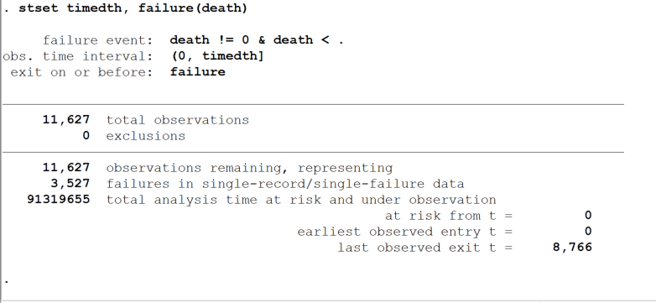
Code: stset time, failure(death)

Slide 28
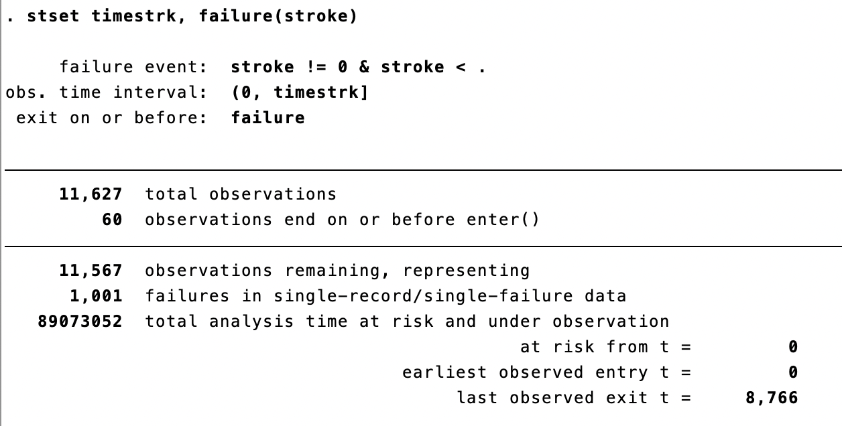
Stroke as outcome

Slide 29
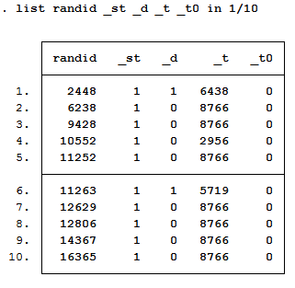
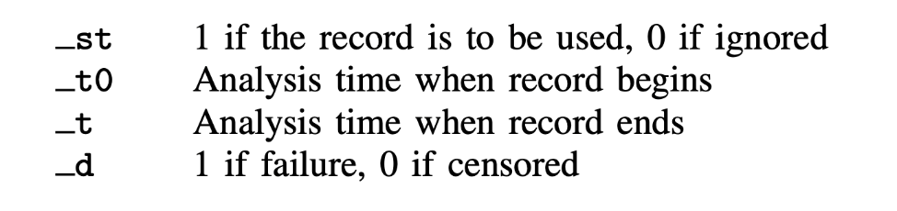
Kaplan-Meier Graphs
What does stset actually do?
Tells Stata that you have survival data, by creating a few new variables to make calculations easier

Slide 30
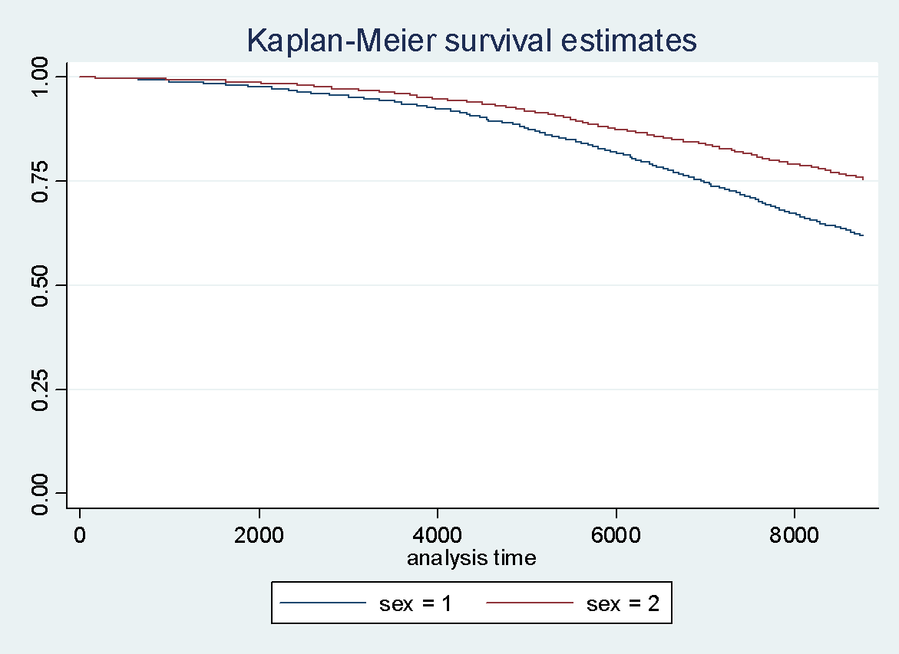
Kaplan-Meier Graphs
sts graph, by(sex)
Note: The stset command prepped the data. Now, if you want to create a Kaplan-Meier graph, you do not need to repeat information about the outcome or the time-to-outcome

Slide 31
Kaplan-Meier Graphs
Should note that you can add many, many options to sts graph
See help sts graph for more information
If you want to get tricky, go for it. Try adding tick-marks on the axes, or adding a title

Slide 32
Tests with Kaplan-Meier Graphs
So far, we obtained p-values to test hypotheses for whether two means are different across categories, and whether the distribution of a categorical variable is different across categories
Now we will get a p-value to test (in some situations) whether the survival experience of two groups differs over time
sts test [exposureCat]
exposureCat is a variable that contains different levels of exposure
Tests the null hypothesis that ‘the survival experience for study participants in each category is the same’
Notes:
A non-statistically rigorous takeaway: if p is less than 0.05, you think the two groups have different survival experiences
If p is greater than 0.05, you can’t reject the hypothesis that the survival experiences are the same

Slide 33
Don’t Forget
Before running sts graph or sts test (or any sts command), you need to first run stset, to tell Stata that you are doing survival analysis
“survival” more broadly means “time to event,” and can be time to any event (cancer relapse, foster care reunification, baseball World Series victories)
. sts test (sex)
failure _d: death
analysis time _t: timedth
Log-rank test for equality of survivor functions
| Events Events
sex | observed expected
------+-------------------------
1 | 1919 1449.83
2 | 1608 2077.17
------+-------------------------
Total | 3527 3527.00
chi2(1) = 258.06
Pr>chi2 = 0.0000

